Slide 1
Transformers and Pre-trained Language Models
Abdul Samad
CS 458 Spring 2023
Week 11

Slide 2
Lecture Content
Understanding self-attention
Key, Query and Value
Simple example of self-attention

Slide 3
Dot Product
Let's say we have two 3-dimensional vectors, A and B:
A = [1, 2, 3] B = [4, 5, 6]
A · B = (1 x 4) + (2 x 5) + (3 x 6) = 4 + 10 + 18 =32
Activity 1: Let's say we have two 2-dimensional vectors, A and B, represented as follows: A = [3, 5] B = [-2, 4], dot product of A and B ?
Activity2: Let's say we have two 4-dimensional vectors, A and B, represented as follows: A = [1, 2, 3, 4] B = [-4, 0, 2, 5], dot product of A and B?

Slide 4
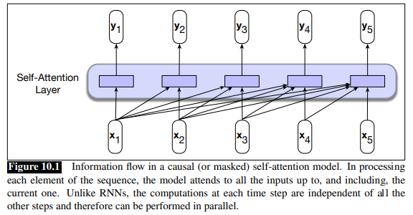
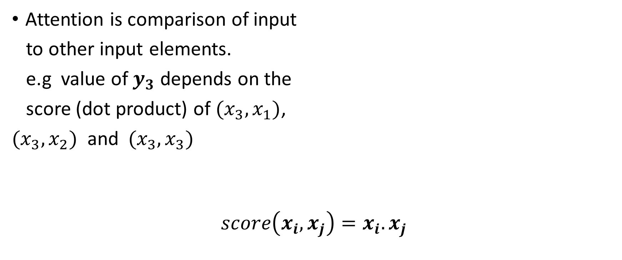
Self Attention
Attention is comparison of input
to other input elements.
e.g value of $y_{3}$ depends on the
score (dot product) of $(x_{3},x_{1})$,
$(x_{3},x_{2})$ and${(x}_{3},x_{3})$
$$score\left(x_{i},x_{j}\right)=x_{i}.x_{j}$$
Notes:
The result of a dot product is a scalar value ranging from −∞ to ∞, the larger the value the more similar the vectors that are being compared. Continuing with our example, the first step in computing $y_{3}$ would be to compute three scores: $x_{3} · x_{1}$, $x_{3} · x_{2}$ and $x_{3} · x_{3}$.

Slide 5
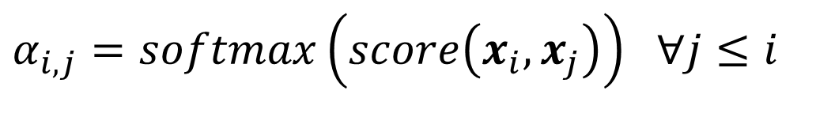

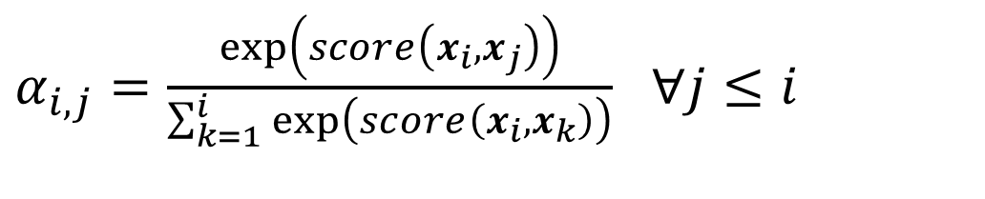
Self Attention
$α_{i,j}=softmax\left(score\left(x_{i},x_{j}\right)\right)$ $∀j≤i$
$α_{i,j}=\frac{\exp\left(score\left(x_{i},x_{j}\right)\right)}{\sum_{k=1}^{i}{\exp\left(score\left(x_{i},x_{k}\right)\right)}}$ $∀j≤i$
$$y_{i}=\sum_{j≤i}{α_{ij}x_{j}}$$
Notes:
Then to make effective use of these scores, we’ll normalize them with a softmax to create a vector of weights, $α_{i,j}$, that indicates the proportional relevance of each input to the input element $i$ that is the current focus of attention.
a set of comparisons to relevant items in some context, a normalization of those scores to provide a probability distribution, followed by a weighted sum using this distribution. The output y is the result of this straightforward computation over the inputs.

Slide 6












Query, Key, Value
Considering the output $y_{3}$
$$x_{3}$$
$$query$$
$$x_{1},x_{2},x_{3}$$
$$key$$
$$x_{1},x_{2},x_{3}$$
$$value$$
$$Attention Values$$
$$soft(score\left(x_{3},x_{1}\right)) =α_{31}$$
$$soft\left(score\left(x_{3},x_{2}\right)\right)=α_{32}$$
$$soft\left(score\left(x_{3},x_{3}\right)\right)=α_{33}$$
$${α_{31}x_{1}}_{ }+{α_{32}x_{2}}_{}+α_{33}x_{3}=y_{3}$$
Notes:
• As the current focus of attention when being compared to all of the other preceding inputs. We’ll refer to this role as a query.
• In its role as a preceding input being compared to the current focus of attention. We’ll refer to this role as a key.
And finally, as a value used to compute the output for the current focus of attention.
Do an activity

Slide 7


Key, Query and Value Matrices
To capture the roles, transformer has 3 matrices
Transformer project each $x_{i}$ into query, key and value vectors
$$W^{Q},W^{K},W^{V}$$
$${q_{i}=W}^{Q}x_{i} ;{k_{i}=W}^{K}x_{i} :{v_{i}=W}^{V}x_{i}$$
$$W^{Q}{,W}^{K},W^{V}∈R^{d×d}, x_{i},y_{i}∈R^{1×d}$$

Slide 8
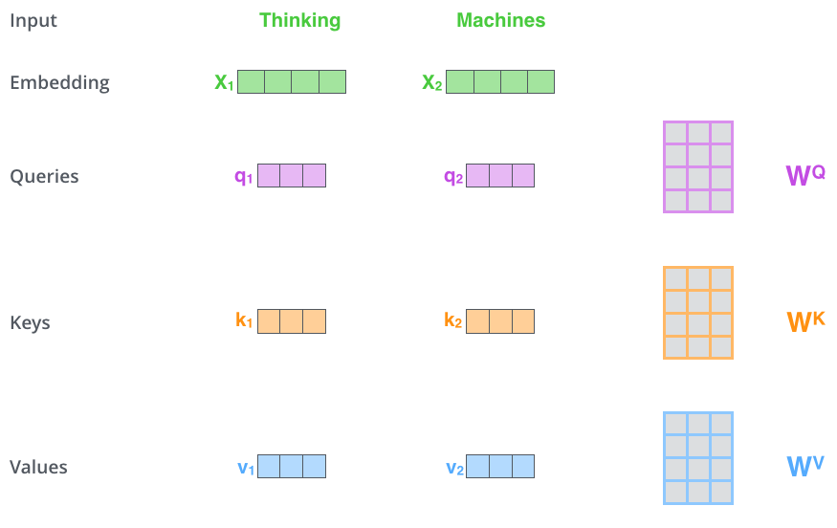
Key, Query and Value Matrices

Slide 9
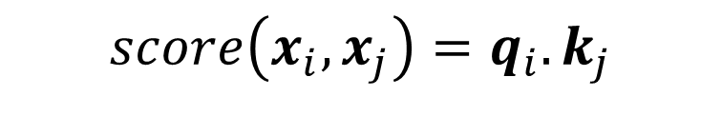
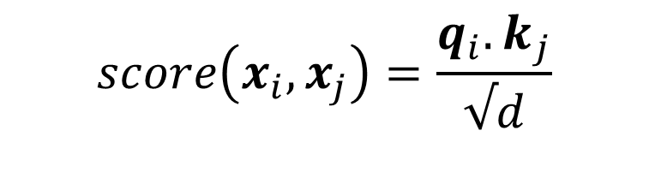

Self-attention (improved version)
$$score\left(x_{i},x_{j}\right)=\frac{{q_{i}.k}_{j}}{√d}$$
$$score\left(x_{i},x_{j}\right)=q_{i}.k_{j}$$
$α_{i,j}=\frac{\exp\left(score\left(x_{i},x_{j}\right)\right)}{\sum_{k=1}^{i}{\exp\left(score\left(x_{i},x_{k}\right)\right)}}$ $∀j≤i$
$$y_{i}=\sum_{j≤i}{α_{ij}v_{j}}$$
Notes:
The result of a dot product can be an arbitrarily large (positive or negative) value. Exponentiating such large values can lead to numerical issues and to an effective loss of gradients during training. To avoid this, the dot product needs to be scaled in a suitable fashion. A scaled dot-product approach divides the result of the dot product by a factor related to the size of the embeddings before passing them through the softmax. A typical approach is to divide the dot product by the square root of the dimensionality of the query and key vectors (dk), leading us to update our scoring function one more time, replacing Eq. 10.1 and Eq. 10.6 with Eq. 10.8:

Slide 10
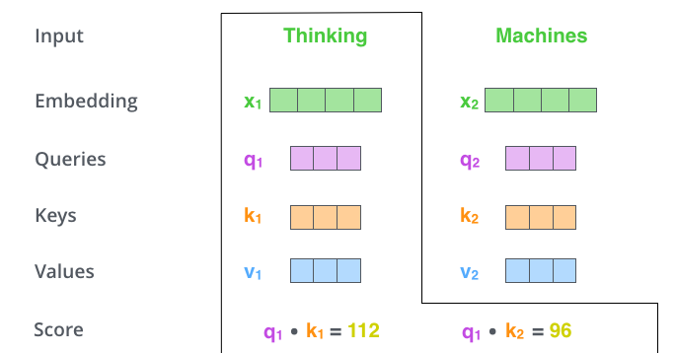

Slide 11
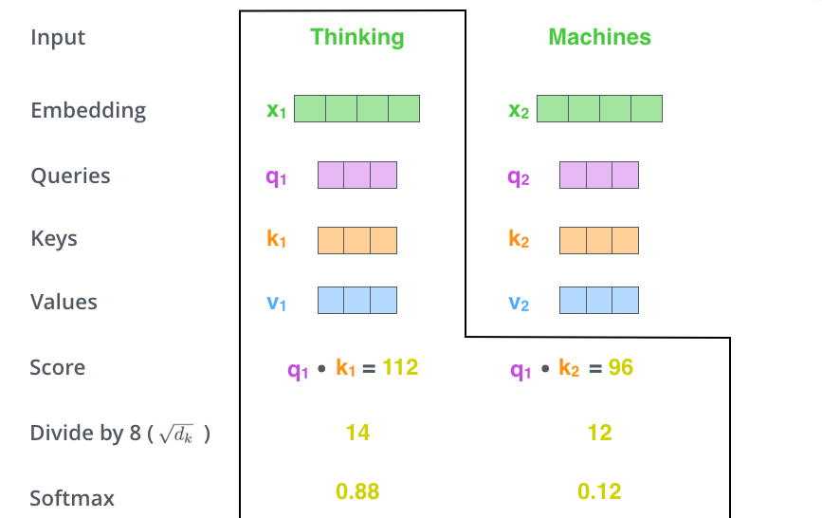

Slide 12
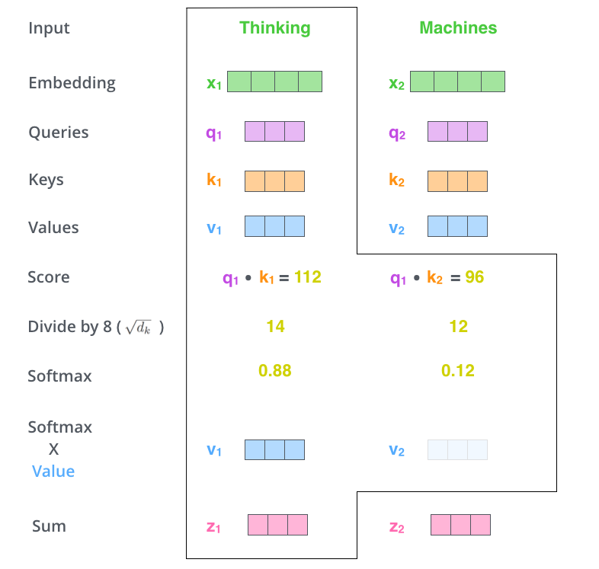

Slide 13
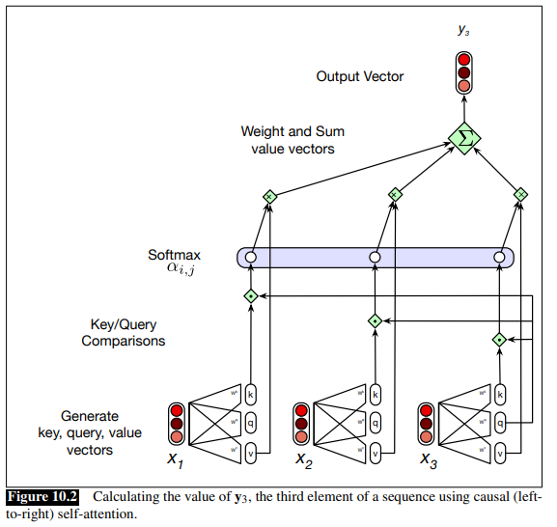

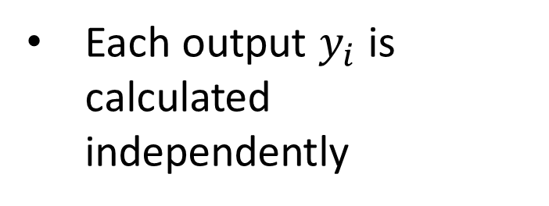
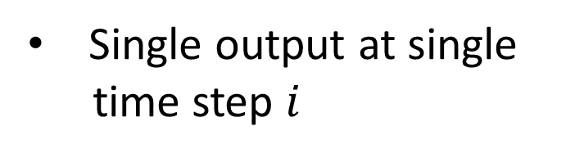
Visual look of calculating $y_{3}$
Single output at single
time step $i$
Each output $y_{i}$ is calculated independently

Slide 14
Recourses Used
https://web.stanford.edu/~jurafsky/slp3/

